Slide 1
Rule Based Logics
Logic for Artificial Intelligence
Yi Zhou

Slide 2
  Content
    Production rules
    Horn logic and Prolog
    Datalog
    Answer set programming
    Rule based logic vs classical logic

Slide 3
  Content
    Production rules
    Horn logic and Prolog
    Datalog
    Answer set programming
    Rule based logic vs classical logic

Slide 4
Facts and Template
  Facts are represented within templates
( <object or relation> <attribute_1> <attribute_2>...<attribute_k> )
  Examples
  (is_a <relationship> <name1><name2>)
    a template
  (is_a father John Mary)
    a fact

Slide 5
Production Rules
  Productions are transformation rules
  Gives one string from another string
    e.g.,
      AB -> CD
  Useful for things like compilers, as well as Production Systems

Slide 6
Production Rules
  A production rule consists of two parts
    left and right
  left side also known as
    condition
    antecedent
  right side also known as
    conclusion
    action
    consequent

Slide 7
Production Rules
  Antecedent part of the rule describes the facts or conditions that must exist for the rule to fire
  Consequent describes
    the facts that will be established, or
    the action that will be taken
IF (conditions) THEN (actions)
IF (antecedents) THEN (consequents)

Slide 8
Production Rules
  Condition elements can be:
    a negation of a fact (means absence of this fact);
  i.e. logical NOT
  e.g. If NOT (sky_is cloudy)
    expressions with variables or wild cards; a wild card is a variable which can be satisfied by any value; e.g. temperature > 120.

Slide 9
Production Rules
Examples
  IF (Gauge is OK) AND [TEMPERATURE] > 120
THEN Cooling system is in the state of overheating
  IF (Presentation is Dull) AND (Voice is Monotone)
THEN Lecture is boring

Slide 10
Production Rules
Examples
  IF (Gauge is OK) AND [TEMPERATURE] < 100
THEN Cooling system is functioning normally
  IF NOT (Presentation is Dull) AND (Voice is Lively)
THEN Lecture is Great

Slide 11
The Inference Process
  Antecedent Matching
    matches facts in working memory against antecedents of rules
    each combination of facts that satisfies a rule is called an instantiation
    each matching rule is added to the conflict set or agenda

Slide 12
The Inference Process
  One rule at a time fires
  Rule must be selected from the Agenda
  Some selection strategies:
    recency
      triggered by the most recent facts
    specificity
  rules prioritised by the number of condition elements
    matches rules with fewer instantiations

Slide 13
The Inference Process
  Rule selection:
    refraction
      once a rule has fired, cannot fire again for a period of time
        certain number of cycles or permanently
    salience
      based on priority number attached to each rule
    random
      choose a rule at random from the agenda

Slide 14
The Inference Process
  Execution of the rule
    can modify working memory
      add facts
      remove facts
      alter existing facts
    alter rules
    perform an external task

Slide 15
The Inference Process
  Inference work repetitively
    match facts
    perform inference
    fire rules
    modify facts
    repeat
  continues until no more productions in the agenda

Slide 16
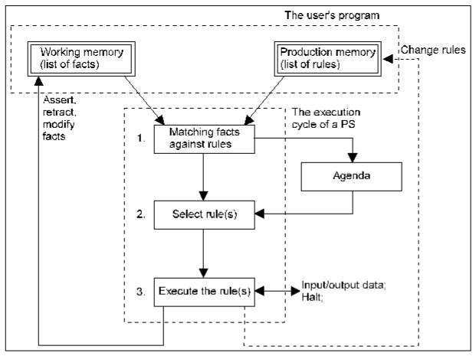
Production System Cycle

Slide 17
Advantages
  Universal computational mechanisms
    can represent any computational process, including a production system
  Universal function approximators
    can approximate any function given a sufficient number of rules

Slide 18
Advantages
  Intuitive
    close to how humans articulate knowledge
    easy to get rules out of a client / user
  Readable
    rules are easy to read
  Explanatory power
    can clearly show how a conclusion was reached

Slide 19
Advantages
  Expressive
    well crafted rules can cover a wide range of situations
    few rules are needed for some problems
  Modular
    each rule is a separate piece of knowledge
    rules can be easily added or deleted

Slide 20
Disadvantages
  Handling uncertainty
    how to deal with inexact values?
    if a value is unknown, how to represent it?
    concepts like tall, short, fat, thin
  Sequential
    one rule at a time fires
    results can depend on which rule fires first

Slide 21
Disadvantages
  Elucidating the rules
    how to get the rules in the first place?
    who wants to write down 5,000 rules?
  Completeness of the rules
    do the rule cover every possibility?
    what happens if they don’t?

Slide 22
  Content
    Production rules
    Horn logic and Prolog
    Datalog
    Answer set programming
    Rule based logic vs classical logic

Slide 23
Horn clauses
A Horn clause is a sentence of the form:
  (∀x) P₁(x) ∧ P₂(x) ∧ ... ∧ P_{n}(x) → Q(x)
where
  there are 0 or more P_{i}s and 0 or 1 Q
  the P_{i}s and Q are positive (i.e., non-negated) literals
Equivalently: P₁(x) ∨ P₂(x) … ∨ P_{n}(x) where the P_{i} are all atomic and at most one of them is positive
Prolog is based on Horn clauses
Horn clauses represent a subset of the set of sentences representable in FOL

Slide 24
Horn clauses II
Special cases
  P₁ ∧ P₂ ∧ … P_{n} → Q
  P₁ ∧ P₂ ∧ … P_{n} → false
  true → Q
These are not Horn clauses:
  p(a) ∨ q(a)
  (P ∧ Q) → (R ∨ S)

Slide 25
Forward chaining
Proofs start with the given axioms/premises in KB, deriving new sentences using GMP until the goal/query sentence is derived
This defines a forward-chaining inference procedure because it moves “forward” from the KB to the goal [eventually]
Inference using GMP is complete for KBs containing only Horn clauses

Slide 26
Forward chaining example
KB:
  allergies(X) → sneeze(X)
  cat(Y) ∧ allergic-to-cats(X) → allergies(X)
  cat(Felix)
  allergic-to-cats(Lise)
Goal:
  sneeze(Lise)

Slide 27
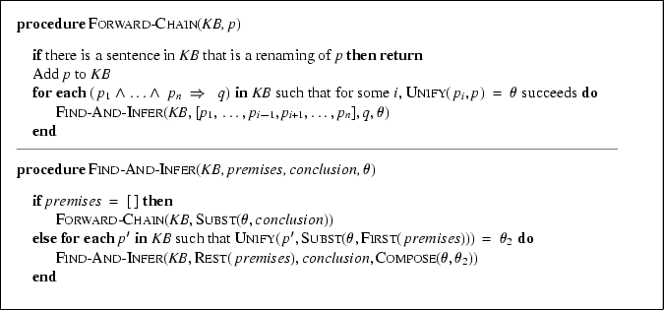
Forward chaining algorithm

Slide 28
Backward chaining
Backward-chaining deduction using GMP is also complete for KBs containing only Horn clauses
Proofs start with the goal query, find rules with that conclusion, and then prove each of the antecedents in the implication
Keep going until you reach premises
Avoid loops: check if new subgoal is already on the goal stack
Avoid repeated work: check if new subgoal
  Has already been proved true
  Has already failed

Slide 29
Backward chaining example
KB:
  allergies(X) → sneeze(X)
  cat(Y) ∧ allergic-to-cats(X) → allergies(X)
  cat(Felix)
  allergic-to-cats(Lise)
Goal:
  sneeze(Lise)

Slide 30
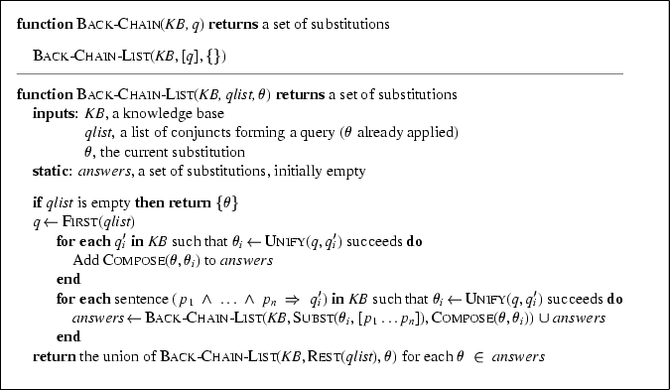
Backward chaining algorithm

Slide 31
Forward vs. backward chaining
FC is data-driven
  Automatic, unconscious processing
  E.g., object recognition, routine decisions
  May do lots of work that is irrelevant to the goal
BC is goal-driven, appropriate for problem-solving
  Where are my keys? How do I get to my next class?
  Complexity of BC can be much less than linear in the size of the KB

Slide 32
Resolution
Resolution is a sound and complete inference procedure for FOL
Reminder: Resolution rule for propositional logic:
  P₁ ∨ P₂ ∨ ... ∨ P_{n}
  ¬P₁ ∨ Q₂ ∨ ... ∨ Q_{m}
  Resolvent: P₂ ∨ ... ∨ P_{n} ∨ Q₂ ∨ ... ∨ Q_{m}
Examples
  P and ¬ P ∨ Q : derive Q (Modus Ponens)
  (¬ P ∨ Q) and (¬ Q ∨ R) : derive ¬ P ∨ R
  P and ¬ P : derive False [contradiction!]
  (P ∨ Q) and (¬ P ∨ ¬ Q) : derive True

Slide 33
Resolution in first-order logic
Given sentences
  P₁ ∨ ... ∨ P_{n}
  Q₁ ∨ ... ∨ Q_{m}
in conjunctive normal form:
  each P_{i} and Q_{i} is a literal, i.e., a positive or negated predicate symbol with its terms,
if P_{j} and ¬Q_{k} unify with substitution list θ, then derive the resolvent sentence:
  subst(θ, P₁ ∨... ∨ P_{j-1} ∨ P_{j+1} ... P_{n} ∨ Q₁ ∨ …Q_{k-1} ∨ Q_{k+1} ∨... ∨ Q_{m})
Example
  from clause P(x, f(a)) ∨ P(x, f(y)) ∨ Q(y)
  and clause ¬P(z, f(a)) ∨ ¬Q(z)
  derive resolvent P(z, f(y)) ∨ Q(y) ∨ ¬Q(z)
  using θ = {x/z}

Slide 34
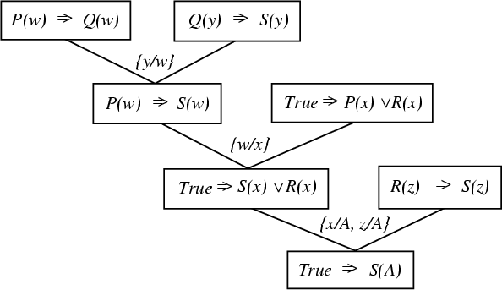
A resolution proof tree

Slide 35
Refutation resolution proof tree
¬allergies(w) v sneeze(w)
¬cat(y) v ¬allergic-to-cats(z) ∨ allergies(z)
w/z
¬cat(y) v sneeze(z) ∨ ¬allergic-to-cats(z)
cat(Felix)
y/Felix
sneeze(z) v ¬allergic-to-cats(z)
allergic-to-cats(Lise)
z/Lise
sneeze(Lise)
¬sneeze(Lise)
false
negated query

Slide 36
Practice example
Did Curiosity kill the cat
Jack owns a dog. Every dog owner is an animal lover. No animal lover kills an animal. Either Jack or Curiosity killed the cat, who is named Tuna. Did Curiosity kill the cat?
These can be represented as follows:
  A. (∃x) Dog(x) ∧ Owns(Jack,x)
  B. (∀x) ((∃y) Dog(y) ∧ Owns(x, y)) → AnimalLover(x)
  C. (∀x) AnimalLover(x) → ((∀y) Animal(y) → ¬Kills(x,y))
  D. Kills(Jack,Tuna) ∨ Kills(Curiosity,Tuna)
  E. Cat(Tuna)
  F. (∀x) Cat(x) → Animal(x)
  G. Kills(Curiosity, Tuna)
GOAL

Slide 37
Convert to clause form
  A1. (Dog(D))
  A2. (Owns(Jack,D))
  B. (¬Dog(y), ¬Owns(x, y), AnimalLover(x))
  C. (¬AnimalLover(a), ¬Animal(b), ¬Kills(a,b))
  D. (Kills(Jack,Tuna), Kills(Curiosity,Tuna))
  E. Cat(Tuna)
  F. (¬Cat(z), Animal(z))
Add the negation of query:
  ¬G: (¬Kills(Curiosity, Tuna))
D is a skolem constant

Slide 38
The resolution refutation proof
R1: ¬G, D, {} (Kills(Jack, Tuna))
R2: R1, C, {a/Jack, b/Tuna} (~AnimalLover(Jack), ~Animal(Tuna))
R3: R2, B, {x/Jack} (~Dog(y), ~Owns(Jack, y), ~Animal(Tuna))
R4: R3, A1, {y/D} (~Owns(Jack, D), ~Animal(Tuna))
R5: R4, A2, {} (~Animal(Tuna))
R6: R5, F, {z/Tuna} (~Cat(Tuna))
R7: R6, E, {} FALSE

Slide 39
The proof tree
¬G
D
{}
R1: K(J,T)
C
{a/J,b/T}
R2: ¬AL(J) ∨ ¬A(T)
B
{x/J}
R3: ¬D(y) ∨ ¬O(J,y) ∨ ¬A(T)
A1
{y/D}
R4: ¬O(J,D), ¬A(T)
A2
{}
R5: ¬A(T)
F
{z/T}
R6: ¬C(T)
A
{}
R7: FALSE

Slide 40
Prolog
A logic programming language based on Horn clauses
  Resolution refutation
  Control strategy: goal-directed and depth-first
    always start from the goal clause
    always use the new resolvent as one of the parent clauses for resolution
    backtracking when the current thread fails
    complete for Horn clause KB
  Support answer extraction (can request single or all answers)
  Orders the clauses and literals within a clause to resolve non-determinism
    Q(a) may match both Q(x) <= P(x) and Q(y) <= R(y)
    A (sub)goal clause may contain more than one literals, i.e., <= P1(a), P2(a)
  Use “closed world” assumption (negation as failure)
    If it fails to derive P(a), then assume ~P(a)

Slide 41
  Content
    Production rules
    Horn logic and Prolog
    Datalog
    Answer set programming
    Rule based logic vs classical logic

Slide 42
Datalog Concepts
Atoms
Datalog rules, datalog programs
EDB predicates, IDB predicates
Conjunctive queries
Recursion
Built-in predicates
Negated atoms, stratified programs.
Semantics: least fixpoint.

Slide 43
Predicates and Atoms
- Relations are represented by predicates
- Tuples are represented by atoms.
Purchase( “joe”, “bob”, “Nike Town”, “Nike Air”, 2/2/98)
- arithmetic, built-in, atoms:
X < 100, X+Y+5 > Z/2
- negated atoms:
NOT Product(“Linux OS”, $100, “Microsoft”)

Slide 44
Datalog Rules and Queries
A datalog rule has the following form:
head :- atom1, atom2, …., atom,…
Examples:
PerformingComp(name) :- Company(name,sp,c), sp > $50
AmericanProduct(prod) :-
Product(prod,pr,cat,mak), Company(mak, sp,“USA”)
All the variables in the head must appear in the body.
A single rule can express exactly select-from-where queries.

Slide 45
Datalog Terminology
A datalog program is a set of datalog rules.
A program with a single rule is a conjunctive query.
We distinguish EDB predicates and IDB predicates:
EDB’s are stored in the database, appear only in the bodies
IDB’s are intensionally defined, appear in both bodies and heads

Slide 46
The Meaning of Datalog Rules
AmericanProduct(prod) :-
Product(prod,pr,cat,mak), Company(mak, sp,“USA”)
Consider every assignment from the variables in the body
to the constants in the database.
If each of the atoms in the body is in the database,
then
the tuple for the head is in the relation of the head.

Slide 47
More Examples
CREATE VIEW Seattle-view AS
SELECT buyer, seller, product, store
FROM Person, Purchase
WHERE Person.city = “Seattle” AND
Person.per-name = Purchase.buyer
SeattleView(buyer,seller,product,store) :-
Person(buyer, “Seattle”, phone),
Purchase(buyer, seller, product, store).

Slide 48
More Examples (negation, union)
SeattleView(buyer,seller,product,store) :-
Person(buyer, “Seattle”, phone),
Purchase(buyer, seller, product, store)
not Purchase(buyer, seller, product, “The Bon”)
Q5(buyer) :- Purchase(buyer, “Joe”, prod, store)
Q5(buyer) :- Purchase(buyer, seller, store, prod),
Product(prod, price, cat, maker)
Company(maker, sp, country),
sp > 50.

Slide 49
Defining Views
SeattleView(buyer,seller,product,store) :-
Person(buyer, “Seattle”, phone),
Purchase(buyer, seller, product, store)
not Purchase(buyer, seller, product, “The Bon”)
Q6(buyer) :- SeattleView(buyer, “Joe”, prod, store)
Q6(buyer) :- SeattleView(buyer, seller, store, prod),
Product(prod, price, cat, maker)
Company(maker, sp, country),
sp > 50.

Slide 50
Meaning of Datalog Programs
Start with the facts in the EDB and iteratively
derive facts for IDBs.
Repeat the following until you cannot derive any new facts:
Consider every assignment from the variables in
the body to the constants in the database.
If each of the atoms in the body is made true by the
assignment, then,
add the tuple for the head into the relation of
the head.

Slide 51
Transitive Closure
Suppose we are representing a graph by a relation Edge(X,Y):
Edge(a,b), Edge (a,c), Edge(b,d), Edge(c,d), Edge(d,e)
b
a
d
e
c
I want to express the query:
Find all nodes reachable from a.

Slide 52
Recursion in Datalog
Path( X, Y ) :- Edge( X, Y )
Path( X, Y ) :- Path( X, Z ), Path( Z, Y ).
Semantics: evaluate the rules until a fixedpoint:
Iteration #0: Edge: {(a,b), (a,c), (b,d), (c,d), (d,e)}
Path: {}
Iteration #1: Path: {(a,b), (a,c), (b,d), (c,d), (d,e)}
Iteration #2: Path gets the new tuples:
(a,d), (b,e), (c,e)
Iteration #3: Path gets the new tuple:
(a,e)
Iteration #4: Nothing changes -> We stop.
Note: number of iterations depends on the data. Cannot be
anticipated by only looking at the query!

Slide 53
Model-Theoretic Semantics
An interpretation is an assignment of extensions to the EDB and IDB rules.
An interpretation of a DB is a model for it whenever it satisfies the rules:
  I.e., if you apply the rules, you get nothing new.
The least fixpoint model of a datalog program is also the intersection of all of its models (for a given EDB extension).

Slide 54
Built in Predicates
Rules may include atoms with built-in predicates:
ExpensiveProduct(X) :- Product(X,Y,P) & P > $100
But: we need to restrict the use of built-in atoms in rules.
P(X) :- R(X) & X<Y
What does this mean?
We could use active domain semantics, but that’s problematic.
Hence, we require that every variable that appears in a built-in
atom also appears in a relational atom.

Slide 55
Negated Subgoals
Rules may include negated subgoals, but in restricted forms:
P(X,Y) :- Between(X,Y,Z) & NOT Direct(X,Z)
Bad:
P(X, Y) :- R(X) & NOT S(Y)
Bad but ok:
P(X) :- R(X) & NOT S(X,Y)
We’ll rewrite as:
S’(X) :- S(X,Y)
P(X) :- R(X) & NOT S’(X)

Slide 56
Stratified Rules
A predicate P depends – (+) on a predicate Q if:
Q appears negated (positive) in a rule defining P.
If there is a cycle in the dependency graph that involves a - edge,
the datalog program is not stratified.
Example:
p(X) :- r(X) & NOT q(X)
q(X) :- r(X) & NOT p(X)
Suppose r has the tuple {1}.

Slide 57
Subtleties with Stratified Rules
Example:
p(X) :- r(X)
q(X) :- s(X) & NOT p(X).
Suppose: R = {1}, and S = {1,2}
One solution: P = {1} and Q = {2}
Another solution: P={1,2} and Q={}.
Perfect model semantics: apply the rules stratum after stratum.

Slide 58
Deductive Databases
General idea: some relations are stored (extensional), others are defined by datalog queries (intensional).
Many research projects (MCC, Stanford, Wisconsin) [Great Ph.D theses!]
SQL3 realized that recursion is useful, and added linear recursion.
Hard problem: optimizing datalog performance.
Ideas from deductive databases made it into the mainstream.

Slide 59
  Content
    Production rules
    Horn logic and Prolog
    Datalog
    Answer set programming
    Rule based logic vs classical logic

Slide 60
Non-Stratified Rules
A predicate P depends – (+) on a predicate Q if:
Q appears negated (positive) in a rule defining P.
If there is a cycle in the dependency graph that involves a - edge,
the datalog program is not stratified.
Example:
p(X) :- r(X) & NOT q(X)
q(X) :- r(X) & NOT p(X)
Suppose r has the tuple {1}.

Slide 61
3-Valued Models
Needed for “well-founded semantics.”
Model consists of:
  A set of true EDB facts (all other EDB facts are assumed false).
  A set of true IDB facts.
  A set of false IDB facts (remaining IDB facts have truth value “unknown”).

Slide 62
Well-Founded Models
Start with instantiated rules.
Clean the rules = eliminate rules with a known false subgoal, and drop known true subgoals.
Two modes of inference:
  “Ordinary”: if the body is true, infer head.
  “Unfounded sets”: assume all members of an unfounded set are false.

Slide 63
Unfounded Sets
U is an unfounded set (of positive, ground, IDB atoms) if every remaining instantiated rule with a member of U in the head also has a member of U in the body.
Note we could never infer any member of U to be true.
But assuming them false is still “metalogic.”

Slide 64
Example
p :- q, q :- p
{p,q} is an unfounded set.
So is ∅.
Note the property of being an unfounded set is closed under union, so there is always a unique, maximal unfounded set.

Slide 65
Constructing the Well-Founded Model
REPEAT
“clean” instantiated rules;
make all ordinary inferences;
“clean” instantiated rules;
find the largest unfounded set and make its atoms false;
UNTIL no changes;
make all remaining IDB atoms
“unknown”;

Slide 66
Example
win(X) :- move(X,Y) & NOT win(Y)
with these moves:
1
2
3
4
5
6

Slide 67
Instantiated, Cleaned Rules
win(1) :- NOT win(2)
win(2) :- NOT win(1)
win(2) :- NOT win(3)
win(3) :- NOT win(4)
win(4) :- NOT win(5)
win(5) :- NOT win(6)
No ordinary
inferences.
{win(6)} is the
largest unfounded
set. Infer
NOT win(6).

Slide 68
Second Round
win(1) :- NOT win(2)
win(2) :- NOT win(1)
win(2) :- NOT win(3)
win(3) :- NOT win(4)
win(4) :- NOT win(5)
win(5) :-
Infer win(5).
{win(4)} is the
largest unfounded
set. Infer
NOT win(4).

Slide 69
Third Round
win(1) :- NOT win(2)
win(2) :- NOT win(1)
win(2) :- NOT win(3)
win(3) :-
win(5) :-
Infer win(3).
No nonempty
unfounded set,
so done.

Slide 70
Example --- Concluded
Well founded model is:
{win(3), win(5), NOT win(4), NOT win(6)}.
The remaining IDB ground atoms --- win(1) and win(2) --- have truth value “unknown.”
Notice that if both sides play best, 3 and 5 are a win for the mover, 4 and 6 are a loss, and 1 and 2 are a draw.
1
2
3
4
5
6

Slide 71
Another Example
p :- q r :- p & q q :- p s :- NOT p & NOT q
First round: no ordinary inferences.
{p, q} is an unfounded set, but {p, q, r} is the largest unfounded set.
Second round: infer s from NOT p and NOT q.
Model: {NOT p, NOT q, NOT r, s}.

Slide 72
Alternating Fixedpoint
Instantiate and “clean” the rules.
In “round 0,” assume all IDB ground atoms are false.
In each round, apply the GL transform to the EDB plus true IDB ground atoms from the previous round.

Slide 73
Alternating Fixedpoint --- 2
Process converges to an alternation of two sets of true IDB facts.
Even rounds only increase; odd rounds only decrease the sets of true facts.
In the limit, true facts are true in both sets; false facts are false in both sets, and “unknown” facts alternate.

Slide 74
Previous Win Example
1
2
3
4
5
6
win(1) :- NOT win(2)
win(2) :- NOT win(1)
win(2) :- NOT win(3)
win(3) :- NOT win(4)
win(4) :- NOT win(5)
win(5) :- NOT win(6)

Slide 75
Computing the AFP
1
2
3
4
5
6
Round
win(1)
win(2)
win(3)
win(4)
win(5)
win(6)
0
1
2
3
4
5
0
1
0
1
0
1
0
1
0
1
0
1
0
1
0
1
1
1
0
1
0
0
0
0
0
1
1
1
1
1
0
0
0
0
0
0

Slide 76
Another Example
p :- q r :- p & q
q :- p s :- NOT p & NOT q
Round
p
q
r
s
0
1
2
0
0
0
0
0
0
0
0
0
0
1
1

Slide 77
Yet Another Example
p :- q q :- NOT p
Round
p
q
0
1
2
0
1
0
Notice that we may
not use positive
IDB fact q from
previous round to
infer p.
0
1
0
Notice how p
is inferred only
after we infer
q on this round

Slide 78
Stable Models --- Intuition
A model M is “stable” if, when you apply the rules to M and add in the EDB, you infer exactly the IDB portion of M.
But … when applying the rules to M, you can only use non-membership in M.

Slide 79
Example
The Win program again:
win(X) :- move(X,Y) & NOT win(Y)
with moves:
M = EDB + {win(1), win(2)} is stable.
  Y = 3, X = 1 yields win(1).
  Y = 3, X = 2 yields win(2).
  Cannot yield win(3).
1
2
3

Slide 80
Gelfond-Lifschitz Transform (Formal Notion of Stability)
Instantiate rules in all possible ways.
Delete instantiated rules with any false EDB or arithmetic subgoal (incl. NOT).
Delete instantiated rules with an IDB subgoal NOT p(…), where p(…) is in M.
Delete subgoal NOT p(…) if p(…) is not in M.
Delete true EDB and arithmetic subgoals.

Slide 81
GL Transform --- Continued
Use the remaining instantiated rules plus EDB to infer all possible IDB ground atoms.
Then add in the EDB.
Result is GL(M ).
M is stable iff GL(M ) = M.

Slide 82
Example
The Win program yet again:
win(X) :- move(X,Y) & NOT win(Y)
with moves:
M = EDB + {win(1), win(2)}.
After steps (1) and (2):
1
2
3
Step (3): neg-
ated true IDB.
win(1) :- move(1,2) & NOT win(2)
win(1) :- move(1,3) & NOT win(3)
win(2) :- move(2,3) & NOT win(3)

Slide 83
Example --- Continued
win(1) :- move(1,3) & NOT win(3)
win(2) :- move(2,3) & NOT win(3)
Step (5): true
EDB subgoal.
Step (4): negated
false IDB subgoal.
Remaining rules have true (empty) bodies.
Infer win(1), win(2).
GL(M ) = EDB + {win(1), win(2)} = M.

Slide 84
Bottom Line on the GL Transform
You can use (positive or negative) IDB and EDB facts from M to satisfy or falsify a negated subgoal.
You can use a positive EDB fact from M to satisfy a positive subgoal.
But you can only use a positive IDB fact to satisfy a positive IDB subgoal if that fact has been derived in the final step.

Slide 85
To Make the Point Clear…
If all I have is the instantiated rule p(1) :- p(1), then M = {p(1)} is not stable.
We cannot use the membership of positive IDB subgoal p(1) in M to make the body of the rule true.

Slide 86
The Stable Model
If a program and EDB has exactly one model M with that EDB that is stable, then M is the stable model for the program and EDB.
Otherwise, there is no stable model for this program and EDB.

Slide 87
Example: p:- NOT q, q :- NOT p
{p} is stable.
p :- NOT q
q :- NOT p
Eliminate rule with
a false negated subgoal.
Eliminate
true subgoal
that is the
NOT of IDB.
Infer only p.
Thus, {p} is stable.
Unfortunately, so is {q}.
Thus, this program has no stable model.

Slide 88
p:- p & NOT q, q :- NOT p
{p} is not stable.
p :- p & NOT q
q :- NOT p
Eliminate rule with
a false subgoal.
Eliminate
true negated
subgoal.
Cannot infer p !
GL({p}) = ∅.
{p} is not stable.

Slide 89
Example --- Continued
{q} is stable.
p :- p & NOT q
q :- NOT p
Eliminate rule with
a false negated subgoal.
Eliminate
true negated
subgoal.
Infer only q.
Thus, {q} is stable.
GL({p,q}) = ∅; GL(∅) = {q}.
Thus, {q} is the (unique) stable model.

Slide 90
  Content
    Production rules
    Horn logic and Prolog
    Datalog
    Answer set programming
    Rule based logic vs classical logic

Slide 91
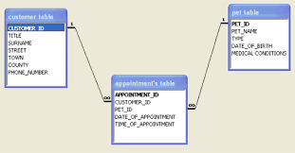
Application – Deductive Database
Datalog

Slide 92

Application – Expert System
Production rule

Slide 93

Application– Natural Language Processing
Production rule

Slide 94
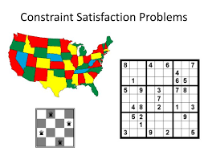
Application– Constrain Satisfaction
Answer set programming

Slide 95

Application– Programming Language
Prolog
Answer set programming

Slide 96
Rule based logics
    Production rule – simple conditioning reflex
    Prolog = first-order logic ∩ rules
    Datalog = recursive production rule
    Well-founded = datalog + negation
    Answer set programming = well-founded+stable

Slide 97
Rule based logic vs Classical logic
 | Rule based logic | Classical logic
representation | rules (with negation) | formula/clause
semantics | forward chaining | model theoretic/truth table
reasoning | forward chaining | resolution
learning | none | none

Slide 98

Thank you!

